Slide 1







Examine neighbourhoods in Toronto based on the number and types of schools available
Capstone Project - The Battle of Neighbourhoods
Bushra

Slide 2
Introduction
The parent always considers choosing the appropriate school for their kids. Therefore, they tend to ask friends, family, and even neighbours, to help them make the right decision.
However, this becomes a challenge, if the parent is moving to another city. Parents at that moment don't have enough information about the schools in that city, and maybe they don't know anyone there. When the parent is moved, the first step is to choose a neighbourhood that they will live in. Their choice depends on several factors as the type of houses, the distance from the workplace, and the most important is the availability of schools in that neighbourhood or a nearby neighbourhood. Therefore, the parent has to explore the schools according to the neighbourhood.

Slide 3
Business Problem
The main goal of this project is to help parents choose the right neighbourhood when they are moved. This will be based on the available schools in that neighbourhood. Therefore, in this project i will explore the neighbourhoods of Toronto city regarding the available schools in each neighbourhood. Schools have different categories, which are: elementary school, high School, middle School and etc. The number of schools in each category will be presented as well.

Slide 4



Data Sources
The data used from Wikipedia which contains all neighbourhood in Toronto city with their postal code.
I use another data set for getting the Latitude Longitude of each neighbourhood.
The available schools in each neighbourhood and their categorises are extracted from foursquare.

Slide 5
Data Preprocessing
Scrape The Data and save it into panda data frame
Handle missing values
Group neighbourhood by postal code
Extract Geospatial data
Merge both data frames

Slide 6
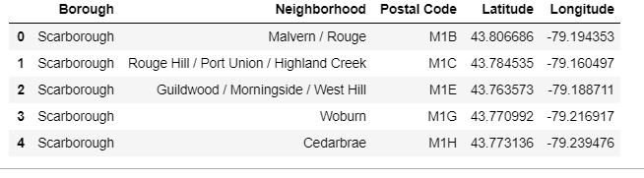
Data Preprocessing
How data looks after this phase, only the first 5 rows

Slide 7
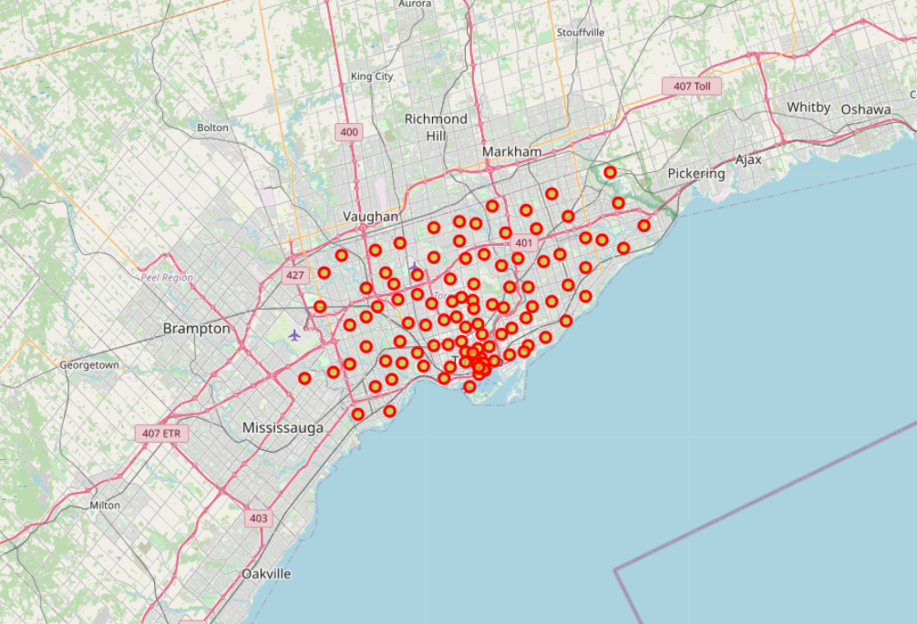
Explore The Neighborhoods
Step 1 : Get the coordinate information of Toronto
Step 2 : Create a map of the Neighbourhoods using folium
The resulted map :

Slide 8
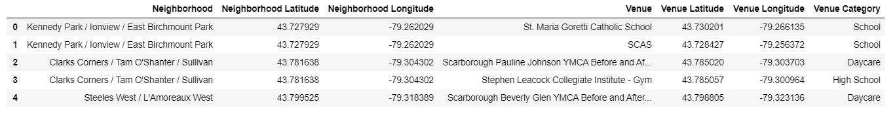
Explore Schools in the Neighbourhoods
Step 1 : Assign Foursquare access information
Step 2 : Get the information from Foursquare
Category Id of schools is : 4bf58dd8d48988d13b941735
Step 3 : Add the extracted information to the data frame based on the postal code.
The result of this phase:

Slide 9
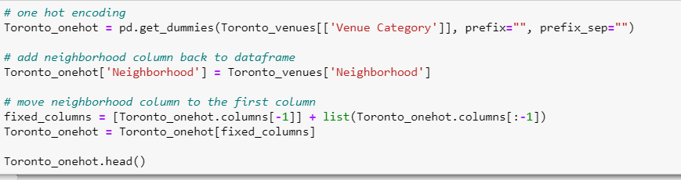
Analyze Each Neighborhood
# 1 :
# 2 :

Slide 10
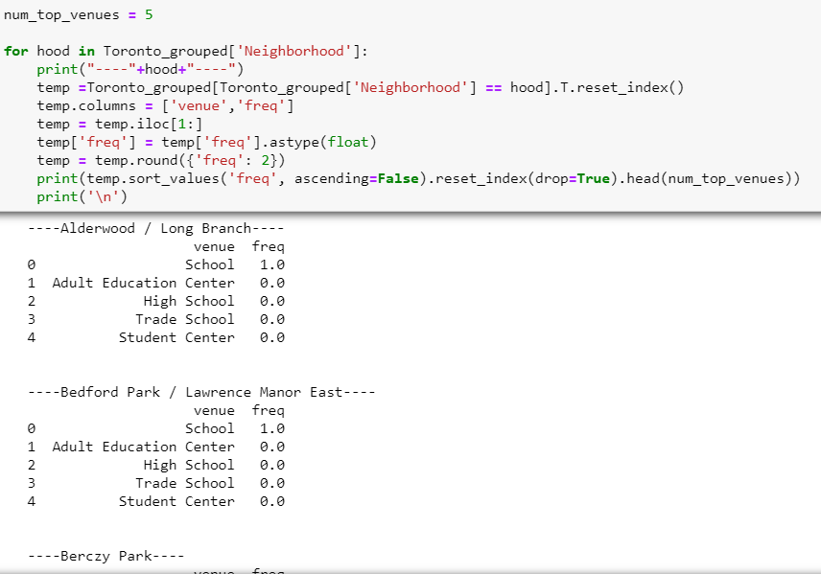
Analyze Each Neighborhood
# 3 :

Slide 11
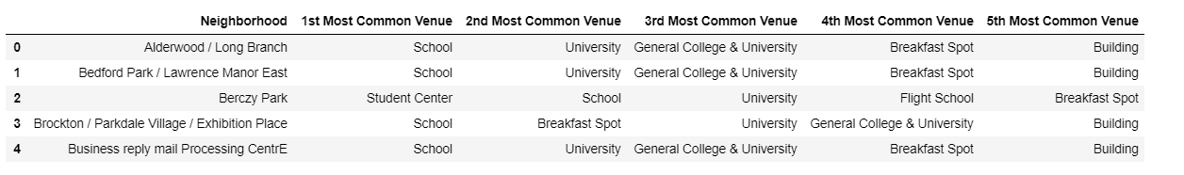
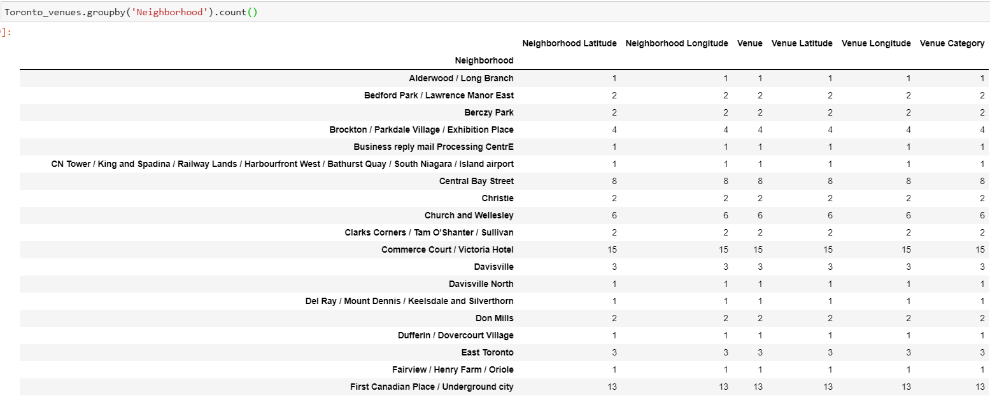
Analyze Each Neighborhood
#4 : Extract and display the top 5 venues for each neighbourhood
#5 :

Slide 12
Cluster Neighbourhoods Based on Schools
Step 1: Run k-means to cluster the neighbourhood into 4 clusters
Step 2: Create a new data frame that includes the cluster as well as the top 10 venues for each neighbourhood
Step 3: Visualize the resulting clusters on a map
The results are presented in the next two slides

Slide 13
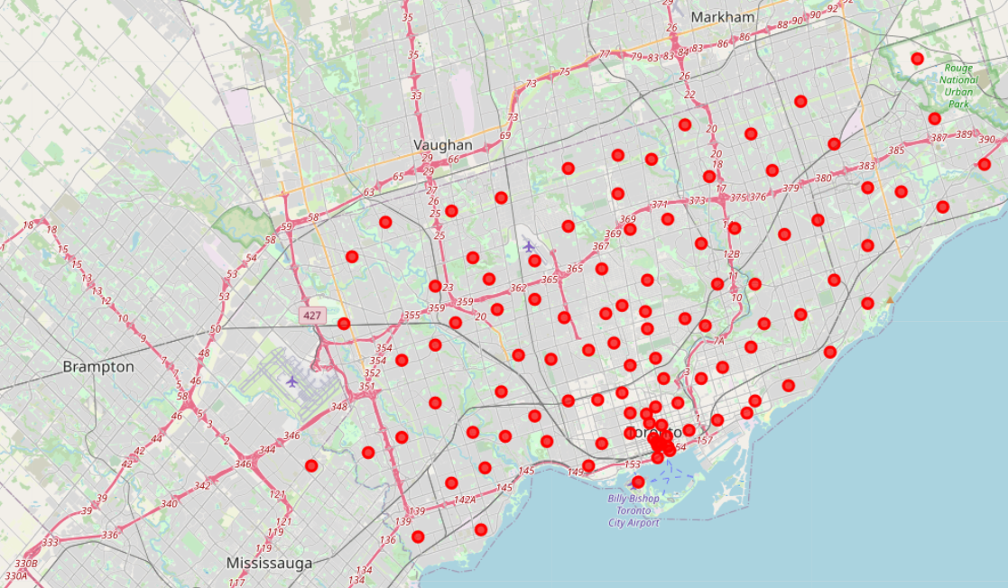
Cluster Neighbourhoods Based on Schools

Slide 14
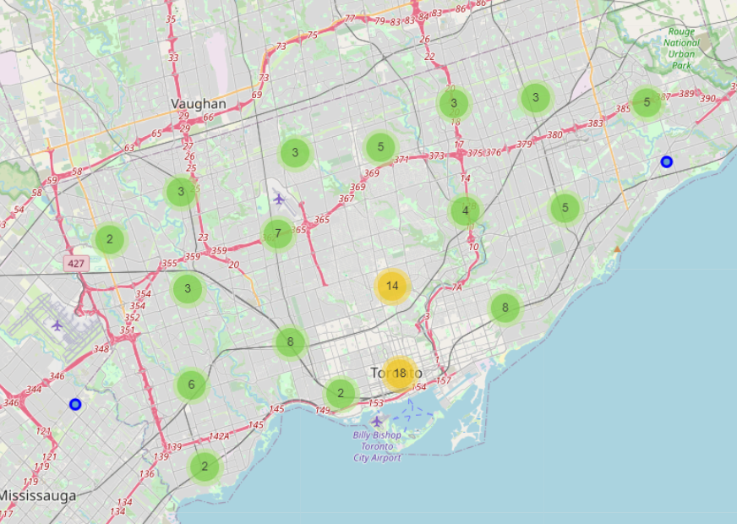
Cluster Neighbourhoods Based on Schools

Slide 15
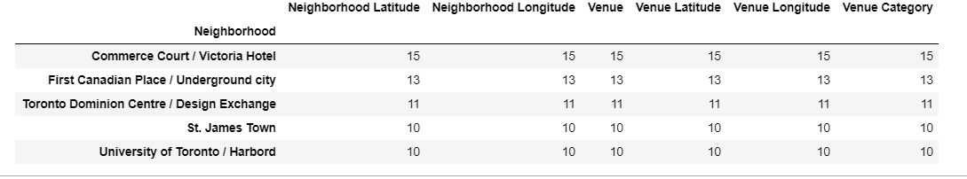
Results
The result of each phase of this project has been presented above. However, parents know can use this data to see the available of schools in Toronto neighborhood. The can see the type of schools as well, and the number of schools in each neighborhood.
The table below shows the top 5 Neighborhood that have the highest number of schools. Commerce Court / Victoria Hotel has the highest number of schools which is 15 schools. Followed by First Canadian Place / Underground city, Toronto Dominion Centre / Design Exchange, St. James Town and University of Toronto / Harbord.

Slide 16
Discussion
The use of foursquare was useful for this type of projects, that depends mainly on locations. However, I noticed that they have 31 categories under school venue.
However, I recommend to perform similar projects as the following:
1- A project that focus on one type of school and compare between them.
2- A project that compare between number of schools and the size of the neighbourhood. Is there any relationship between them?

Slide 17
Conclusion
To conclude, the choose of the right school is one of parent concerns. This will raise, if the parent dose not know the area or moving to a new area, because their choose of a neighbourhood often depend on the chosen school. Therefore, this project is designed to help parents to explore the schools in Toronto regarding its neighbourhoods. The results shows that Commerce Court / Victoria Hotel has the highest number of schools, that counted as 15 schools. As a recommendation, to do slimier project that compare between number of schools and the size of the neighbourhood.

Slide 18
Thank you

